Slide 1

VIRTUAL MOUSE AND KEYBOARD USING GESTURES FOR RECOGNITION
Batch – C9
K. SATHISH KUMAR (18C11A05C8)
P. SHIRIDI SAI (18C11A05C9)
CH. SRIHARI (18C11A05E4)
B. VINAY (18C11A05H4)
Under the guidance of
M. SHAILAJA M.Tech
Assistant Professor

Slide 2
ABSTRACT
Nowadays computer vision has reached its successful point, where a computer can identify its owner using a simple program of image processing. In this stage of development, people are using this vision in many aspects of day to day life, like Face Recognition, Color detection, Automatic car, etc. In this project, computer vision is used in creating an Virtual mouse and keyboard using hand gestures. The camera of the computer will read the image of different gestures performed by a person’s hand and according to the movement of the gestures the Mouse or the cursor of the computer will move, even perform right and left clicks using different gestures.

Slide 3
INTRODUCTION

Slide 4
OBJECTIVE
The basic objective is to develop a virtual mouse and keyboard using the concepts of hand gesture recognition and image processing which will ultimately move the mouse pointer according to the hand gestures, similarly with the help of the gesture can use keyboard functions which will be defined as per the convenience of the user. Reducing the cost of hardware.
This approach will make tasks trickier and more easier like creating 3D models ,browsing the imaginary part in medical world during surgery and one best thing is that without touching anything it can work even in architectural designs and in automated building.

Slide 5
PROBLEM STATEMENT
Usage of physical mouse and keyboard will get wear and tear someday, which might be a materialistic damage or a functioning problem.

Slide 6
EXISTING SYSTEM
A physical mouse and keyboard is required to work with the system.
Mouse is a physical device where it can wear and tear.
Need a flat surface to use the device effectively.

Slide 7
DRAWBACKS:
They need a flat surface close to the system.
If the battery wears out in a wireless mouse, it cannot be used until it has been replaced.

Slide 8
PROPOSED SYSTEM
The system can able to detect the hand gestures.
Each and every gesture mapped to a mouse functions.
We can perform several mouse functions like single click , double click , scroll , drag and drop.
We can also perform all the keyboard functions by using hand gestures.

Slide 9
ADVANTAGES:
Reduce hardware cost by eliminating use of physical mouse and keyboard.
The main advantage of using hand gestures is to interact with computer as a non-contact human computer.
We can create more mouse functions as we can create many number of gestures easily.
Adding new functionalities takes less amount of time.

Slide 10
ANALYSIS

Slide 11
LITERATURE SURVEY
S.S. Rautray, A. Agrawal, “Real Time Gesture Recognition System for Interaction in Dynamic Environment,” Vol. 4, pp 595- 599. Human Computer Interaction techniques have become a bottleneck in the effective utilization of the available information flow. The development of user interfaces influences the changes in the Human-Computer Interaction (HCI) - 2019.
Z. Shujun, “A Hand Gesture Recognition Method Based on Multi- Feature Fusion and Template Matching. Hand gesture recognition system received great attention in the recent few years because of its manifoldness applications and the ability to interact with machine efficiently through human computer interaction - 2012.

Slide 12
R. Zaman, K. Noor, A. Ibraheem, Hand Gesture Recognition : A Literature Review Gestures can be static (posture or certain pose) which require less computational complexity or dynamic (sequence of postures) which are more complex but suitable for real time environments - 2012.
Mahajan A.R, International Journal on Science and Technology. Image based one time password is also a factor nowadays to enhance the security of One Time Passwords it also includes machine learning algorithms for detection of image OTP’s in 2012.

Slide 13
Sadhana Rao, ” Many works are done using openCV technology that image processing for path holes detection to overcome accidents that’s a main problem in many parts of the world - 2010.

Slide 14
IMPLEMENTATION SPECIFICATIONS
HARDWARE REQUIREMENTS
SOFTWARE REQUIREMENTS

Slide 15
HARDWARE REQUIREMENTS:
Processor : Intel i3
Processor speed : 1.80 GHz
Hard Disk : 1 TB
RAM : 4 GB
Webcam : 30 FPS ( Frames per second )

Slide 16
SOFTWARE REQUIREMENTS:
Operating system : Windows
Coding Language : PYTHON 3.9.6
IDE : PYTHON IDLE
Database : MySQL
Libraries : openCV , mediapipe

Slide 17
MODULE DESCRIPTION
Registration module
Login module
Video accessing module
Gesture recognition module
Event generation module

Slide 18
MODULE-1
REGISTRATION MODULE :
The users can able to register into the system using the credentials.
MODULE-2
LOGIN MODULE :
To access the virtual mouse and the keyboard, the users must log in into the system with their credentials.
MODULE-3
VIDEO ACCESSING MODULE :
By the usage of openCV library methods, we can be able to capture the live video through web cam. We can also perform tasks like face detection, landmark detection and much more.

Slide 19
MODULE-4
GESTURE RECOGNITION MODULE :
By the usage of mediapipe library methods, we can able to recognize the gestures and can be able to visualize the skeleton view.
MODULE-5
EVENT GENERATION MODULE :
Based on the gestures, corresponding mouse events and keyboard events are performed.

Slide 20
UML DIAGRAMS
The Unified Modeling Language(UML) is a general-purpose, developmental, modeling language in the field of software engineering that is intended to provide a standard way to visualize the design of a system.

Slide 21
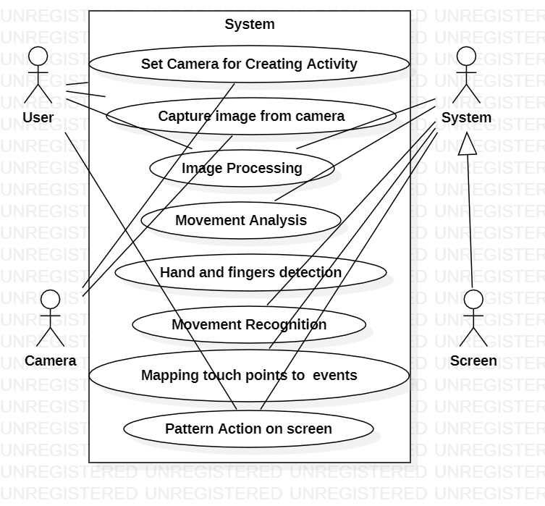
USE CASE DIAGRAM

Slide 22
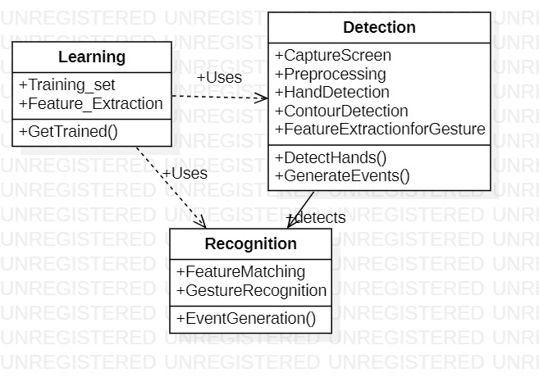
CLASS DIAGRAM

Slide 23
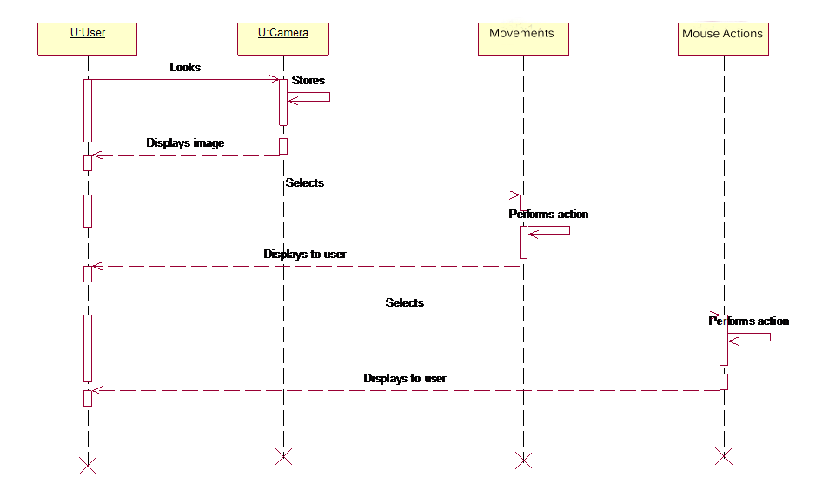
SEQUENCE DIAGRAM

Slide 24
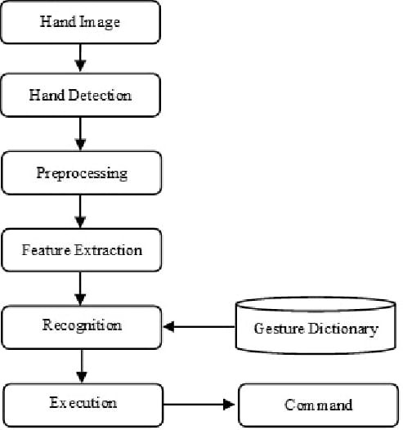
DATA FLOW DIAGRAM

Slide 25
IMPLEMENTATION

Slide 26
TECHNOLOGIES
PYTHON
OPEN-CV
PYAUTOGUI
TKINTER

Slide 27
PYTHON
Python is a popular programming language. It was created by Guido van Rossum, and released in 1991.
It is used for:
web development (server-side),
software development,
Mathematics.
system scripting.

Slide 28
OPEN-CV
OpenCV is the huge open-source library for the computer vision, machine learning, and image processing and now it plays a major role in real-time operation which is very important in today’s systems. By using it, one can process images and videos to identify objects, faces, or even handwriting of a human. When it integrated with various libraries, such as NumPy, python is capable of processing the OpenCV array structure for analysis. To Identify image pattern and its various features we use vector space and perform mathematical operations on these features.

Slide 29

HAND LAND MARKS

Slide 30
PYAUTOGUI
Python pyautogui library is an automation library that allows mouse and keyboard control. Or we can say that it facilitates us to automate the movement of the mouse and keyboard to establish the interaction with the other application using the Python script. It provides many features, and a few are given below.
We can move the mouse and click in the other applications' window.
We can send the keystrokes to the other applications. For example - filling out the form, typing the search query to browser, etc.
We can also take snapshots and give an image.
It allows us to locate a window of the application, and move, maximize, minimize, resizes, or close it.
Display alert and message boxes.

Slide 31
TKINTER
Python offers multiple options for developing GUI (Graphical User Interface). Out of all the GUI methods, tkinter is the most commonly used method. It is a standard Python interface to the Tk GUI toolkit shipped with Python. Python with tkinter is the fastest and easiest way to create the GUI applications. Creating a GUI using tkinter is an easy task.

Slide 32
TESTING

Slide 33
DEBUGGING
The purpose of debugging/testing is to discover errors. Testing is the process of trying to discover every conceivable fault or weakness in a work product.
It is the process of exercising software with the intent of ensuring that the Software system meets its requirements and user expectations and does not fail in an unacceptable manner.
There are various types of test. Each test type addresses a specific testing requirement.

Slide 34
TEST CASES
Inputs | Expected Output | Actual Output | Result
No hands in-front of camera | No detection of hands | No detection of hands | Pass
Single Hand | Detected | Detected | Pass
Two Hands | Detected | Detected | Pass
More Than Two Hands | Only Two Hands Detected | Only Two Hands Detected | Pass
Single Finger Up [0,1,0,0,0] | Mouse moved | Mouse Moved | Pass
Two Fingers Up [0,1,1,0,0] | Mouse movement and Single click | Mouse movement and single click | Pass
Thumb Finger Up [1,0,0,0,0] | Scroll Up | Scroll Up | Pass
Little Finger Up [0,0,0,0,1] | Scroll Down | Scroll Down | Pass
All Fingers Down [0,0,0,0,0] | Application Closed | Application Closed | Pass
Inputs | Expected Output | Actual Output | Result
No hands in-front of camera | No detection of hands | No detection of hands | Pass
Single Hand | Detected | Detected | Pass
Two Hands | Detected | Detected | Pass
More Than Two Hands | Only Two Hands Detected | Only Two Hands Detected | Pass
Single Finger Up [0,1,0,0,0] | Mouse moved | Mouse Moved | Pass
Two Fingers Up [0,1,1,0,0] | Mouse movement and Single click | Mouse movement and single click | Pass
Thumb Finger Up [1,0,0,0,0] | Scroll Up | Scroll Up | Pass
Little Finger Up [0,0,0,0,1] | Scroll Down | Scroll Down | Pass
All Fingers Down [0,0,0,0,0] | Application Closed | Application Closed | Pass

Slide 35
DEPLOYMENT

Slide 36
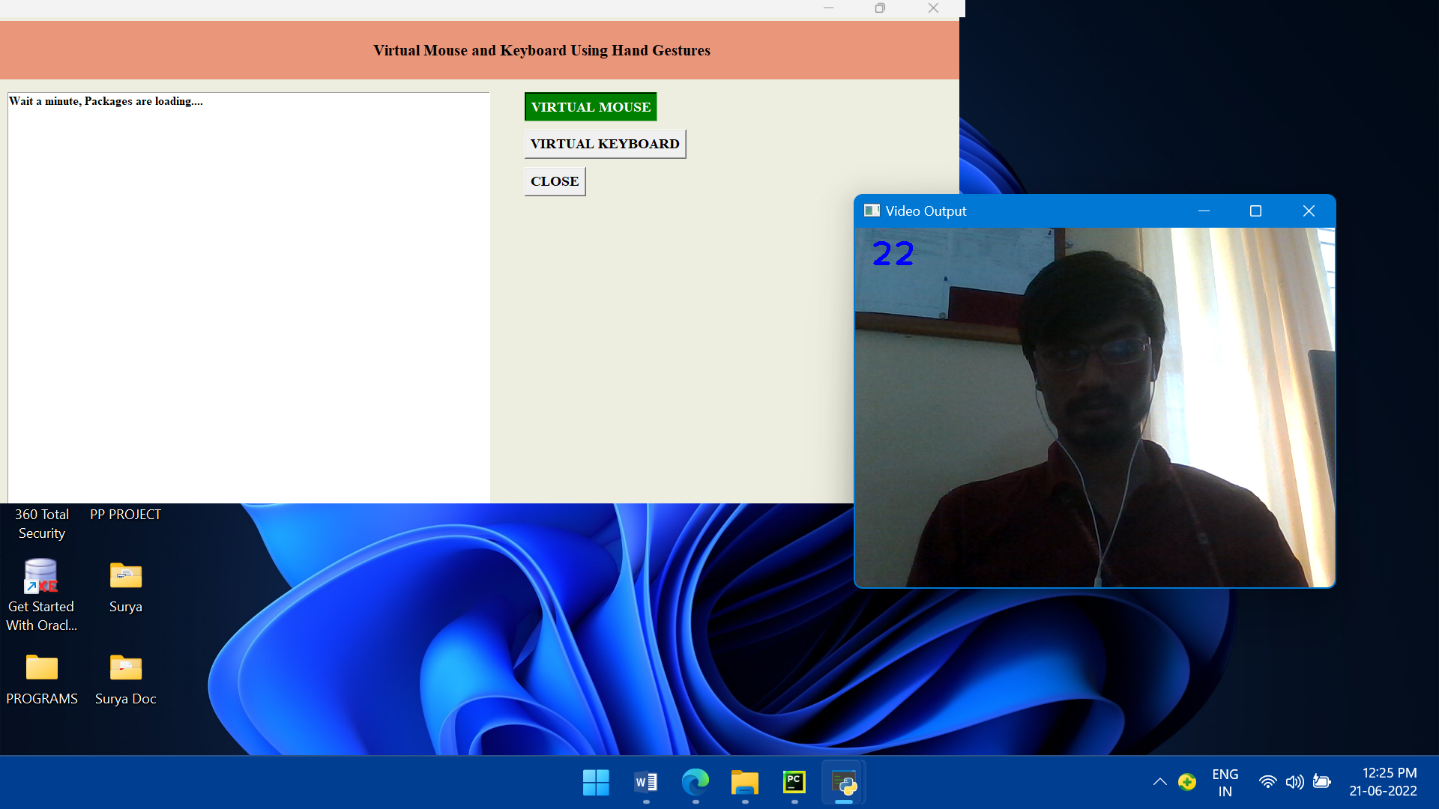

Slide 37
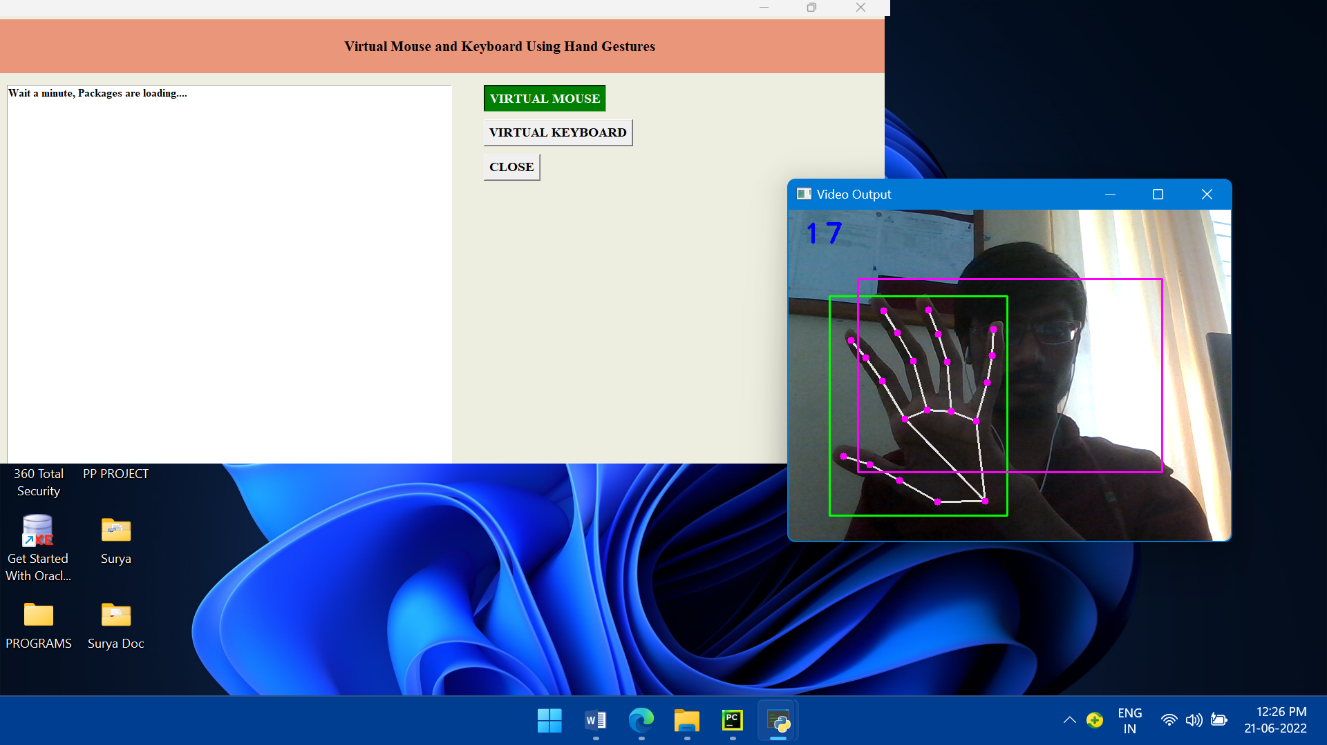

Slide 38
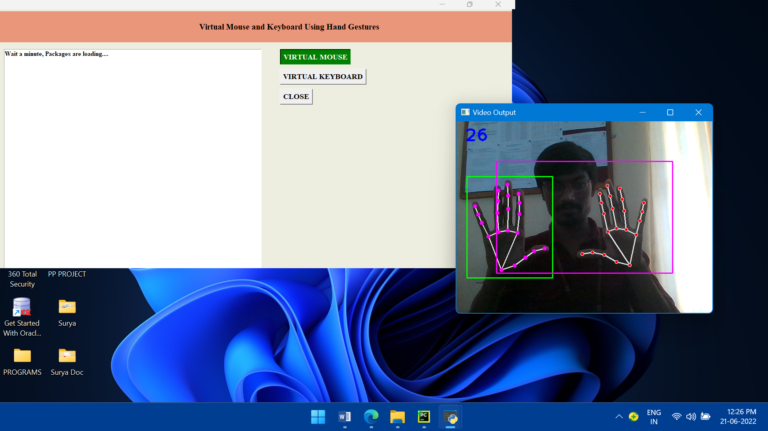

Slide 39
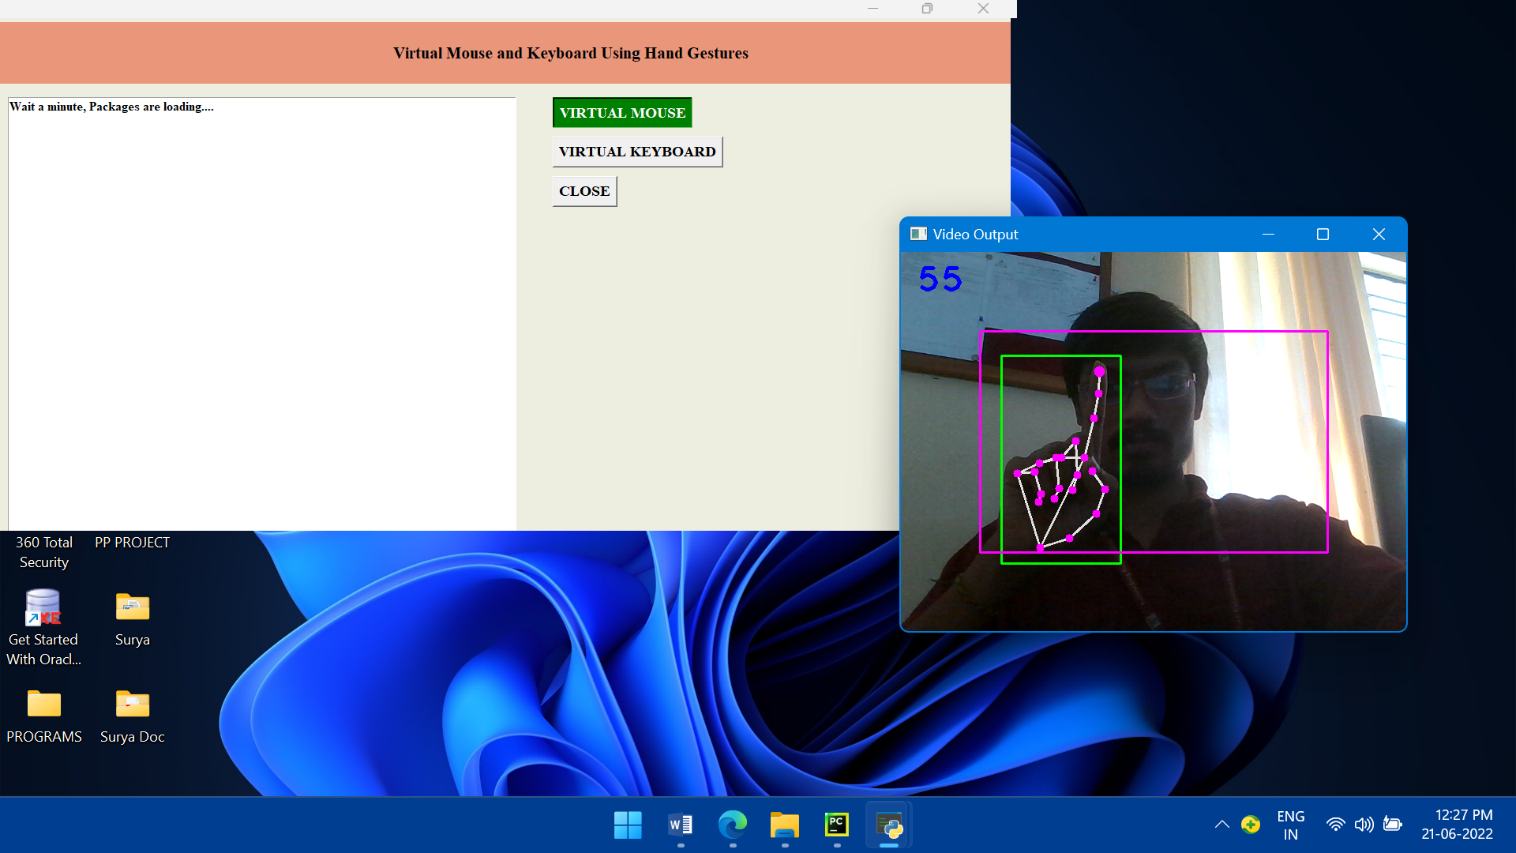

Slide 40


Slide 41
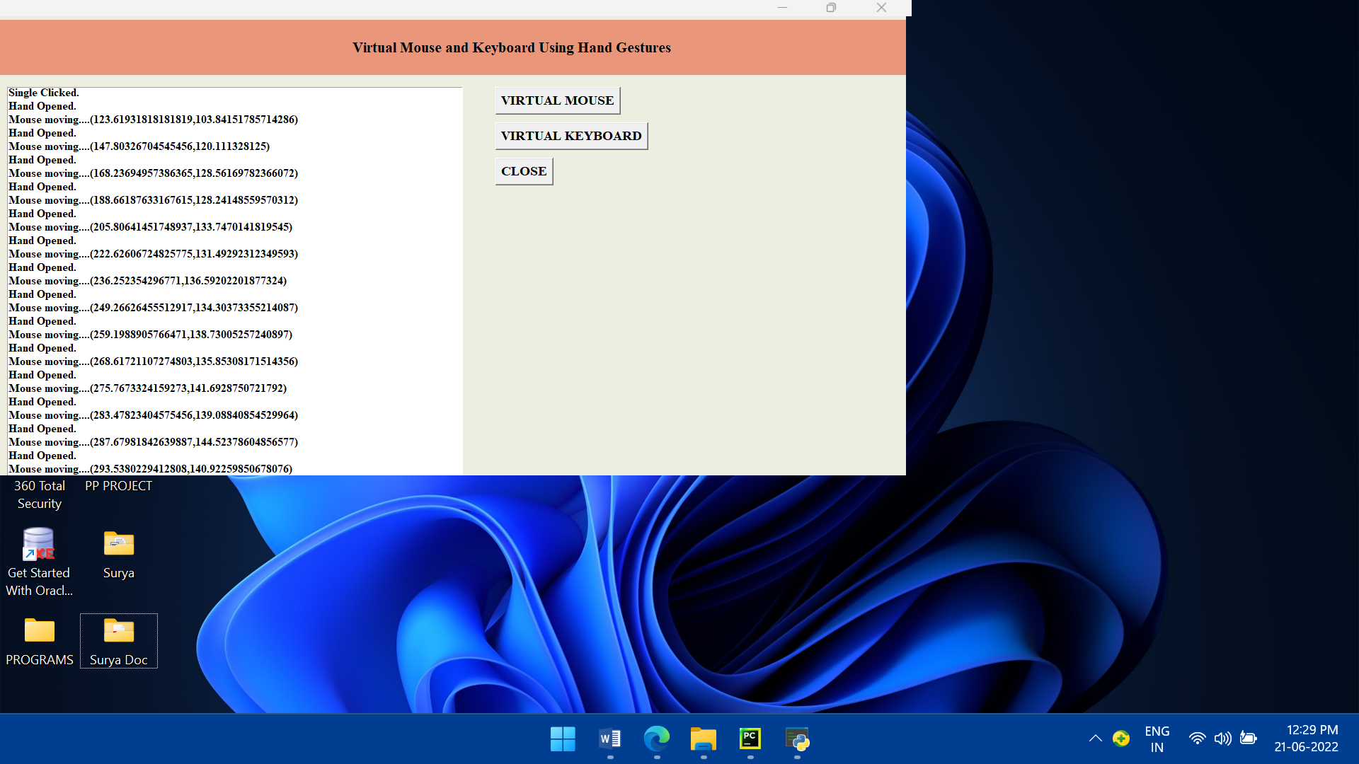

Slide 42
CONCLUSION
In conclusion, a system that recognizes hand gestures and eliminates the need for a mouse and keyboard. This includes mouse cursor movement, drag and click, and keyboard features such as printing alphabets and other keyboard tasks. To separate the color/image of the hand from its background, the skin segmentation procedure is used. The method of removing an arm efficiently overcomes the problem of capturing the entire body in the camera. In summary, the suggested method can detect and recognize hand gestures in order to control mouse and keyboard functions as well as generate a realistic user interface. 3D printing, architectural renderings, and even medical procedures may all be done from anywhere to anyone.

Slide 43
FUTURE ENHANCEMENTS
The work is to make PC understanding projects that can deal with continuous issues and to achieve targets of the affiliations and regular daily existence as well as individuals. There is a degree in encouraging the machines games, talk affirmation machine, language revelation, PC vision, ace systems, progressed mechanics, etc. the more you learn about AI sciences, for instance material science or science, the better. For the normal ways of managing Artificial Intelligence, find out about mind science and the tangible framework. Get to know some Machine vernaculars. It is savvy to focus on one crucial machine language.

Slide 44
REFERENCES
Sugnik roy, Gesture recognition based virtual mouse and keyboard using convex hull method, 2020.
S.S. Rautaray, A. Agrawal, “Real Time Gesture Recognition System for Interaction in Dynamic Environment,” Procedia Technology, Vol. 4, pp 595- 599, 2019.
L.Yun, Z. Lifeng, Z. Shujun, “A Hand Gesture Recognition Method Based on Multi- Feature Fusion and Template Matching”, Procedia Engineering, Vol. 29, 2012.
Mahajan A.R, ”A gestural user interface to Interact with the situation of taking into the whole body into the camera. In computer system ”, International Journal on Science and Technology - 2012.
R. Zaman, K. Noor, A. Ibraheem, “Hand Gesture Recognition:A Literature Review”, International Journal of Artificial Intelligence & Applications (IJAIA), Vol.3, No.4, July 2012.
Sadhana Rao, ” Sixth Sense Technology”, Proceedings of the International Conference on Communication and Computational is utilized to separate the colour/image of hand with its Intelligence– 2010.

Slide 45
THANK YOU

